Slide 1
Maryland’s Integrated Practice Model:
Practice, Policy and the Role of Resource Parents
June 15, 2021
Presenter: Kim Parks-Bourn, LCSW-C, SSA
Program Manager for Practice Innovations

Slide 2
Desired Outcomes
Participants will gain an understanding of Maryland’s Integrated Practice Model (IPM) and Families First Prevention and Services Act; two important practice and policy shifts in Maryland’s child welfare system and what these policy and practice shifts mean for Resource Parents.
Participants will become familiar with the Integrated Practice Model and its the “Resource Parent Practice Profile” and “Teaming between Resource Parents, Families of Origin and Workers Practice Profile.”
Participants will learn more about how resource parents, families of origin and workers can team together to achieve safety, permanency and well-being for children and vulnerable adults.
Participants will have the opportunity to discuss barriers, strategies and opportunities to operationalize the IPM and the practice profiles pertaining to resource parents.

Slide 3
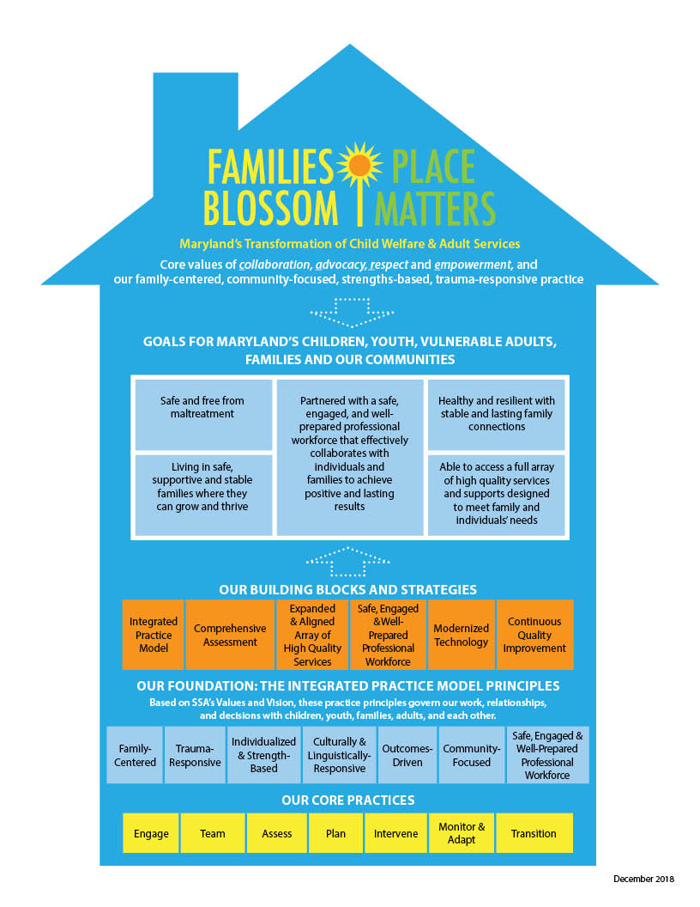
Notes:
RECAP: SSA Strategic Vision, Goals and Outcomes for children, vulnerable adults, families, frontline staff and our community partners. This includes the foundation built from Family Centered Practice, Place Matters, Families Blossoms Initiatives and now our Integrated Practice Model

Slide 4



Maryland’s System Transformation

Slide 5
Family First Prevention Services Act (FFPSA)
Signed into law on February 9, 2018, provides a historic opportunity for child welfare agencies and their partners to improve the lives of children and families touched by the child welfare system.
  Built around three guiding principles: 1) Help families whose children are at risk of removal stay together safely, 2) Ensure that children in foster care can live with a family, and 3) Improve access to high quality residential treatment.
  Expands critical federal resources to keep families together, prevent unnecessary foster care removals and ensure that children grow up in safe and loving families.
  Offers important tools to help States and Tribes improve the quality of services and supports, including new requirements for placement assessments, evidence-based programs, residential treatment and common-sense licensing.
(Source: Implementing the Family First Prevention Services Act: A Technical Guide for Agencies, Policymakers and Other Stakeholders)
Notes:
Family First also recognizes the needs of other populations in the child welfare system who face additional barriers to success. These include families impacted by substance use disorders, older youth who are making the transition to adulthood without a permanent family, pregnant and parenting youth and relatives and other family members who step in to care for children when their parents cannot.

Slide 6
What is the IPM?
  Builds on what we know to be best practices and reinforces our strategic plan (and FFPSA)
  Clarifies expectations for our workforce related to evidence-based practices, such as child and family team meetings, collaborative assessment and parent-child visitation.
  Promotes consistency in how staff engage, team, assess and intervene with families.
  Provides opportunities for children, families, resource caregivers and community partners to monitor and inform our efforts.
  Places individuals’ and families’ safety, permanency and well-being at the center of our child welfare and adult services.
The IPM, along with FFPSA, helps us to ensure that children, families, and vulnerable adults can expect and experience the same high-quality care across the state, regardless of where they reside. It means that children, families and vulnerable adults are better off because of our involvement.
Notes:
Thanks to partnerships with key internal and external stakeholders, we now have an Integrated Practice Model to guide our engagements with families, communities and with each other. The practice model defines new ways to provide services and puts individuals’ and families’ safety and well-being at the center of our child welfare and adult services.
A practice model helps child welfare agencies determine the behavior, skills, and competencies needed to achieve their mission and improve the safety, permanency, and well-being outcomes of the children, youth, and families they serve. Guides the content of policy. Informs the purpose of training.
Shapes continuous quality improvement efforts. Provides an opportunity for children, families, referral agents, and community stakeholders to monitor and inform efforts.

Slide 7
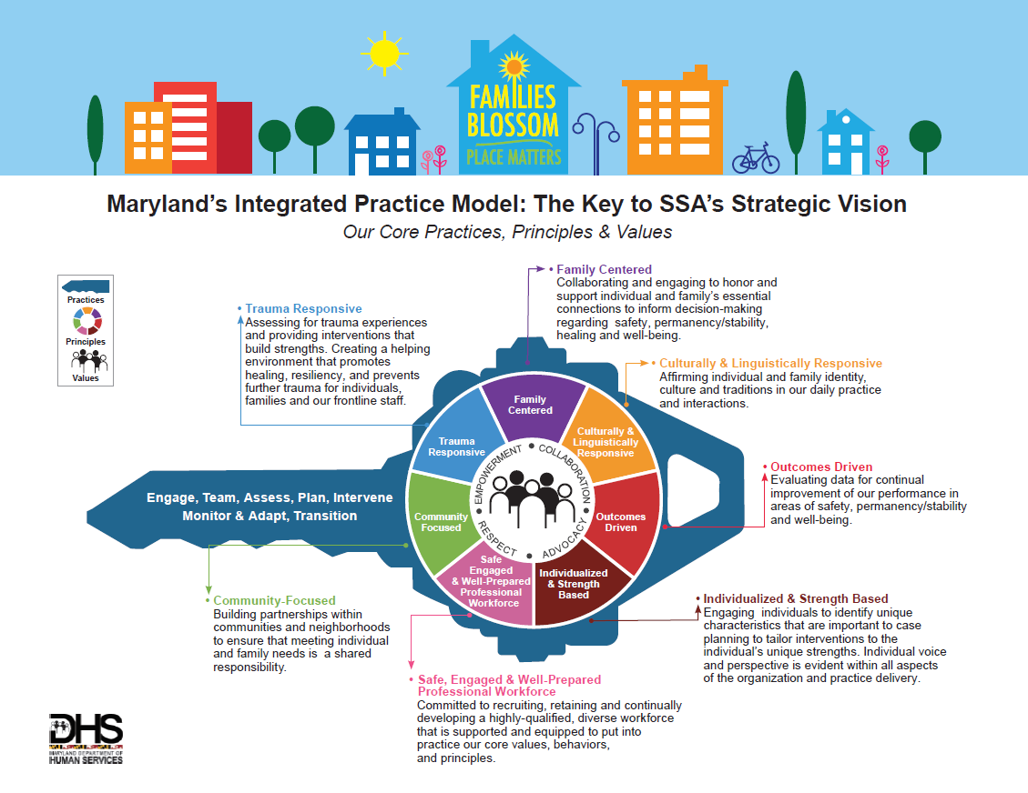
Notes:
kIM - This process is about operationalizing the IPM: We do all the core practices in all of our work. We need to approach this phase of implementation emulating the practice model….and helping LDSS emulate the practice model so they can operationalize the practice model with children, youth, families and vulnerable adults.

Slide 8
IPM Values: C-A-R-E
Collaboration: We honor the importance of building relationships with our families and community, and work to promote safety, stability, permanency and well-being. Individuals and families are active partners in our assessments, planning and decision-making
Advocacy: Staff advocate for the individuals we serve and ensure their rights are maintained. We acknowledge and support the opinions, voices, and strengths of children, youth, vulnerable adults and families in all levels of planning and decision-making.
Respect: We respect and affirm all individuals without imposing opinion or judgment. We value learning about each person’s unique skills and talents, and their expression of race, religion, ethnicity, culture, history, values, traditions, sexual orientation and gender identity.
Empowerment: We support self-expression and individual choices. We believe everyone has the ability to reach their full potential.

Slide 9

Policy and the IPM
SSA-CW 21-04 Promoting Partnerships between Family of Origin and Resource Parents Policy
SSA-CW 21-02 Family Teaming Policy (soon to be released)

Slide 10
Policy and Practice and the IPM
Policy | Practice Expectations | IPM Core Practices and Principles
SSA-CW 21-04 Promoting Partnerships | Icebreaker meetings, comfort calls, teaming and co-parenting contracts | Practices: Engaging, teaming, assessing, planning Principles: Trauma-responsive; Community focused; strengths based and individualized; family centered, safe engaged and well-prepared professional workforce.
SSA-CW 21-02 Family Teaming | Teaming beyond formal meetings, broadened array of meeting types that involve intentional use of teams to enhance protective factors and | Practices: Engaging, teaming, assessing, planning, intervening, monitoring, adapting, transitioning Principles: Trauma-responsive; Community focused; family centered; safe engaged and well-prepared professional workforce; culturally and linguistically responsive

Slide 11
What are Practice Profiles?
A tool for operationalizing a defined strategy, such as Teaming within the IPM
  Promotes a shared understanding of SSA’s practice expectations and requirements
  Builds knowledge, skills and competency
  Uses data and observation to continuously improve practice;
  Ensures leadership and administrative practices are aligned with expectations.
  Metz, A., 2016. Practice Profiles: A Process for Capturing Evidence and Operationalizing Innovations

Slide 12
IPM Practice Profile: Resource Parents
[Feeling heard and respected means] “Inviting me to meetings, listening to my opinions and maybe use some of ideas. If not, tell me why they didn’t use them. It may be a totally valid reason, but if I don’t know it just makes me feel under-valued and disrespected.” (Resource Parent)
The purpose of the Resource Parents Profile is to clarify expectations and share supports for resource parents who are caring for children and/or vulnerable adults involved with the child welfare and adult services system.
Builds on notion that Resource Parents are best able to provide care and support when they are fully informed, represented, and involved directly in the care of children and vulnerable adults in their care.
Resource Parents can be most effective when involved in assisting the agency and family when developing goals, addressing concerns, assessing progress, shared decision-making, and creating plans that build upon strengths, resiliency and other protective factors. Resource parents are an integral part of a team to promote safety, well-being, and stability as well as independence/timely permanency.
Notes:
KIM
(e.g., Family Involvement Meetings, Case Planning, Caseworker Visitation, Birth Parent/Family of Origin, family and Sibling Visitation, Court Hearings, Educational Meetings)

Slide 13
IPM Resource Caregiver Practice Profile
Our Goals as Resource Parents are to:
Create a safe and supportive environment for children, youth and emerging adults in our care.
Be equipped with knowledge and training to address the complex needs of children & youth in care;
Develop relationships with birth parents to provide support and mentorship as needed.
Advocate needs, concerns, and strengths of children, youth and emerging adults in their care and their families of origin that are included in the development of permanency plans.
Partner with children, youth, emerging adults and their families as a member of the family team.
Partner with birth families and families of origin during visits to model and support useful parenting strategies and promote reunification.
Notes:
LARRY

Slide 14
.Resource Parent Profile: IPM Principles in Practice
Family-Centered: We support children, youth, emerging adults and their families of origin by managing their needs and concerns as a member of the family team with the whole family and permanency plan in mind; supporting these needs during family and sibling visits; and by valuing and incorporating their opinions, insights, and wishes
Trauma-Responsive: We proactively work with individuals and families in conjunction with caseworkers to identify topics that may cause a trauma reaction and plan for how to appropriately attend to these responses if they occur during, before or after visits with family or siblings or at other times when trauma reactions may potentially occur.
Outcomes-Driven: We work with the family team to contribute information about the individual or family progress observed in visits as well as information that may indicate the need to closely monitor or adapt service goals and support optimal outcomes for safety, permanence, and well-being.
Individualized & Strengths-Based: We interpret individual and family behavioral as strengths in the context of their trauma; acknowledge each youth, child, or emerging adult in our care as unique and requiring customized attention and support; and voice these specific needs on their behalf as a valuable member of the family team.

Slide 15
Resource Parent Profile: IPM Principles in Practice
Culturally & Linguistically Responsive: We attune and respond to the individual/family’s preferred language and cultural needs, encourage children, youth, and emerging adults to share their values, beliefs, and traditions with us so we can honor and celebrate them accordingly.
Community-Focused: We work with the family team and community supports to collaboratively support the children, youth, and emerging adults in our care as well as seek their assistance during planning and making decisions pertaining to their care.
Safe, Engaged and Well-Prepared Professional Workforce: We demonstrate our values of collaboration, advocacy, respect and empowerment with individuals and families and when we routinely consult our colleagues and DSS staff for support when we experience challenging situations.

Slide 16
IPM Practice Profile: Teaming to Promote Partnerships between Families of Origin, Resource Parents and Workers
Teaming is a centerpiece practice within the Integrated Practice Model (IPM), and an essential means of partnering with children, youth and families to ensuring safety, well-being and timely reunification/permanency.
The Department collaborates with and supports both parents and resource parents. Resource and birth parents should be fully and equally represented, informed, and engaged to support children, youth, and their families and support systems.
As a team, resource parents and birth parents along with the support of the Local Departments of Social Services should be involved in developing goals, addressing concerns, assessing progress, shared decision-making, and creating plans that build upon individual and family strengths, resiliency and other protective factors.
Fostering the partnership between resource parents and birth parents promotes transparency, inclusion, and accountability.
Notes:
KIM

Slide 17
Teaming to Promote Partnerships between Families of Origin, Resource Parents and Workers Practice Profile
Our Goals in teaming between Local Department staff, resource parents and birth parents are to:
Create a safe and supportive environment for children, youth and emerging adults.
Participate in Comfort Calls, Icebreakers and Continuum of Contact to promote support and communicate needs of children and youth
Build a trusting and supportive relationship with families and family supports.
Be equipped with knowledge and training to address the complex needs of children & youth in care;
Develop relationships with birth parents to provide support and mentorship as needed.
Advocate needs, concerns, and strengths of children, youth and emerging adults in the care of resource parents and work together in the development of permanency plans.
Partner during visits to model and support useful parenting strategies, share knowledge of children and youth needs, and promote reunification.
Notes:
KIM

Slide 18
. Teaming to Promote Partnerships: IPM Principles in Practice
Family-Centered: We support children, youth, emerging adults and their birth families or families of origin by managing their needs and concerns as a member of the family team with the whole family and permanency plan in mind; supporting these needs during family and sibling visits; and by valuing and incorporating their opinions, insights, and wishes.
Trauma-Responsive: We minimize re-traumatization of children and youth and identify conversations/topics that may cause a trauma reaction; we plan for and appropriately attend to these responses if they occur during, before or after visits with family or siblings, or at other times when trauma reactions may potentially occur.
Outcomes-Driven: We work with the family team to contribute information about the individual or family progress observed in visits as well as information that may indicate the need to closely monitor or adapt service goals and support optimal outcomes for safety, permanence, and well-being.
Individualized & Strengths-Based: We interpret individual and family behavioral as strengths in the context of their trauma; acknowledge each youth, child, or emerging adult in our care as unique and requiring customized attention and support; and voice these specific needs on their behalf as a valuable member of the family team.

Slide 19
Teaming to Promote Partnerships: IPM Principles in Practice
Culturally & Linguistically Responsive: We attune and respond to the individual/family’s preferred language and cultural needs, encourage children, youth, and emerging adults to share their values, beliefs, and traditions with us so we can honor and celebrate them accordingly.
Community-Focused: We work in partnership with the birth parent’s and family’s natural community; we communicate knowledge of additional resources that may be useful to the family team, and engage community supports in planning and decision-making to collaboratively support children, youth, and emerging adults in care.
Safe, Engaged and Well-Prepared Professional Workforce: We demonstrate our values of Collaboration, Advocacy, Respect and Empowerment with individuals and families and routinely consult our colleagues and DSS staff for support when we experience challenging situations.

Slide 20
Where are there opportunities for Resource Parents to partner and team with families and LDSS?
Family Involvement Meetings/Family Team Decision Meeting (FTDM)
Case Planning
Caseworker Visitation
Birth Parent/Family of Origin, family and Sibling Visitation
Court Hearings
Educational Meetings)

Slide 21
Next Steps
Measuring Success and Practice Change
IPM Coaching

Slide 22
Questions
How can we team to achieve the vision for these practice profiles?
Where do you think we are today in getting to the practice described in the Resource Parent profiles, on a scale of 1-10?
  What would it take to get you to the next higher number?

Slide 23
For More Information
Please contact:
Kim Parks-Bourn, LCSW-C,
Program Manager, Practice Innovations/SSA
Email: Kimberly.bourn@maryland.gov

